Slide 1
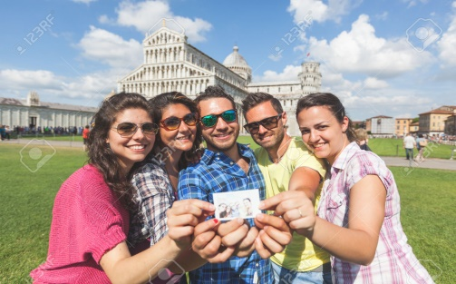
Make My Tour Easy
(Travelling sales men problem)
Project Presentation
Guide: Ishan
Students: Bhishma Sukhavasi
Krishna Chaitanya
Seetha Ramaiah
Avinash Boyapati

Slide 2
Abstract
To ﬁnd the shortest path for a tour using Branch and Bound for ﬁnding the optimal solutions. A branch-and-bound algorithm consists of a systematic enumeration of all candidate solutions, where large subsets of fruitless candidates are discarded ,by using upper and lower estimated bounds of the quantity being optimized.

Slide 3
Introduction
The website deals with creating the ideal path that a tourist would take while traveling between cities.
The solution to any given tour would be the cheapest way to visit a ﬁnite number of cities, visiting each city only once, and then returning to the starting point.

Slide 4
Problem
To design a website to guide a tourist to travel through a set of cities.
Given ‘n’ number of cities and the costs of travelling from one city to another.
Find the shortest tour that visits all cities exactly once and then returns to the starting city.

Slide 5
Solution
The solution to this problem can be given using, branch and bound technique for a least cost travelling sales person problem.
The costs to travel, between all the cities to be covered, is represented in the form of a matrix.
The front end of the website is designed by using HTML(Hyper Text Mark Up Language).

Slide 6
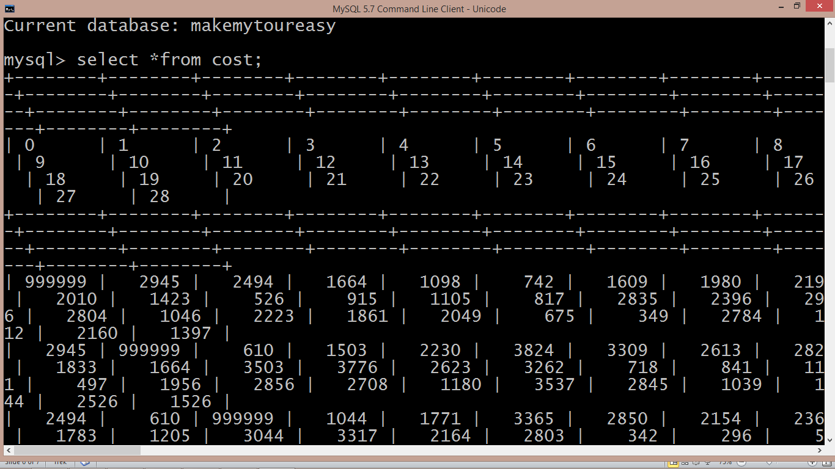
The backend i.e. computing the shortest tour, is designed using PHP.
The costs between one city to each other city are stored in a SQL database and are retrieved when needed.

Slide 7
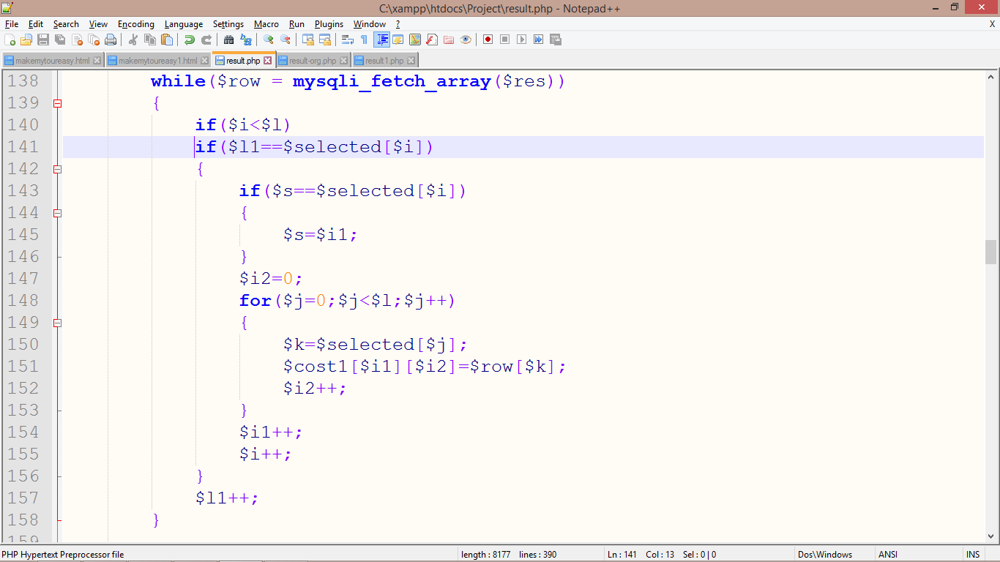
Algorithm
Initially the costs between the cities to be travelled are retrieved from the database using SQL queries and are stored in the matrix form.

Slide 8
Example: Assume a tour between five cities and city
1 be the starting point
Consider the cost matrix:
1 2 3 4 5
1
2
3
4
5
∞ 20 30 10 11
15 ∞ 16 4 2
3 5 ∞ 2 4
19 6 18 ∞ 3
16 4 7 16 ∞

Slide 9
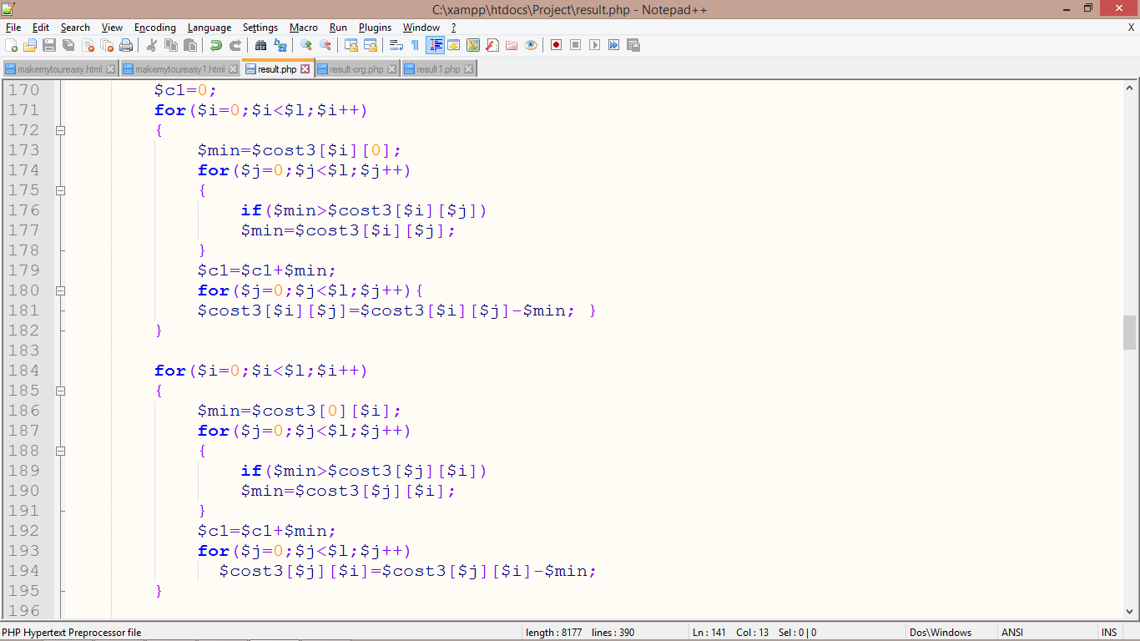
Row and column reduction operations are done on each row and column of the matrix.

Slide 10
After applying row and column reduction:
1 2 3 4 5
1
2
3
4
5
∞ 10 17 0 1
12 ∞ 11 2 0
0 3 ∞ 0 2
15 3 12 ∞ 0
11 0 0 12 ∞
The total cost subtracted is 25.Thus Thus, we know the lower bound of feasible solutions to this problem is 25(c1).

Slide 11
Starting from node ‘1’ the possible next vertices are 2/3/4/5.
So we want to find costs for paths (1,2), (1,3), (1,4), (1,5).
Path(1,2):
1 2 3 4 5
Placing the infinities in 1st row, 2nd column and at position (2,1),
and there by applying reduction on the resultant matrix, we obtain the cost of path (1,2) through the total cost subtracted for reduction.
1
2
3
4
5
∞ ∞ ∞ ∞ ∞
∞ ∞ 16 4 2
3 ∞ ∞ 2 4
19 ∞ 18 ∞ 3
16 ∞ 7 16 ∞
(-0)
(-0)
(-0)
(-0)
(-0)
(-0) (-0) (-0) (-0) (-0)
Cost=c1+(1,2)+0=25+10+0=35.

Slide 12
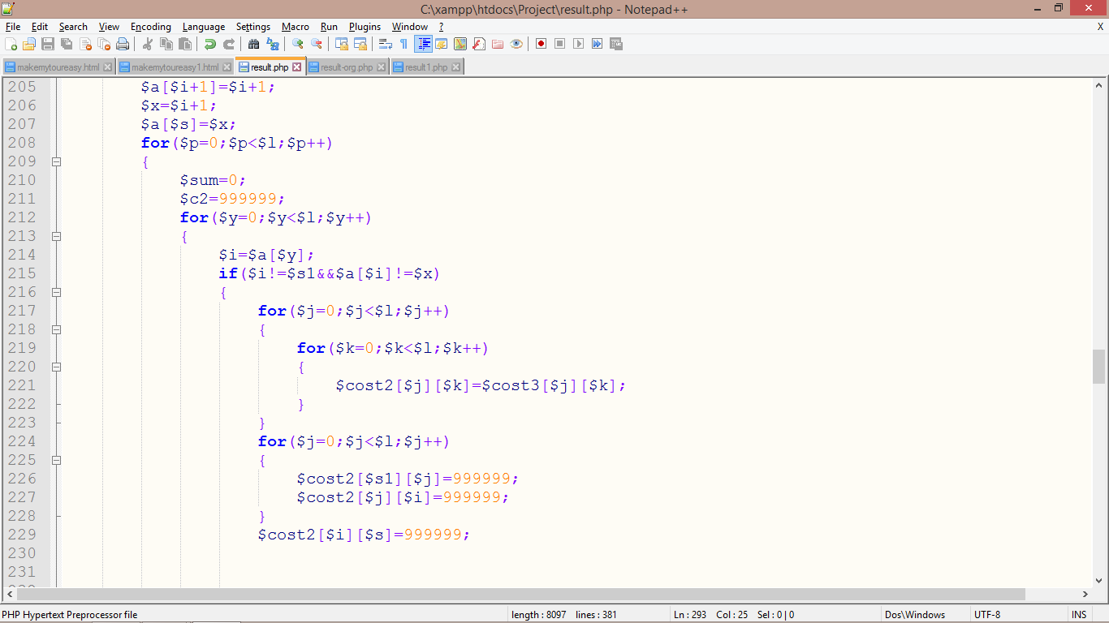
Placing infinities at rejected paths:

Slide 13
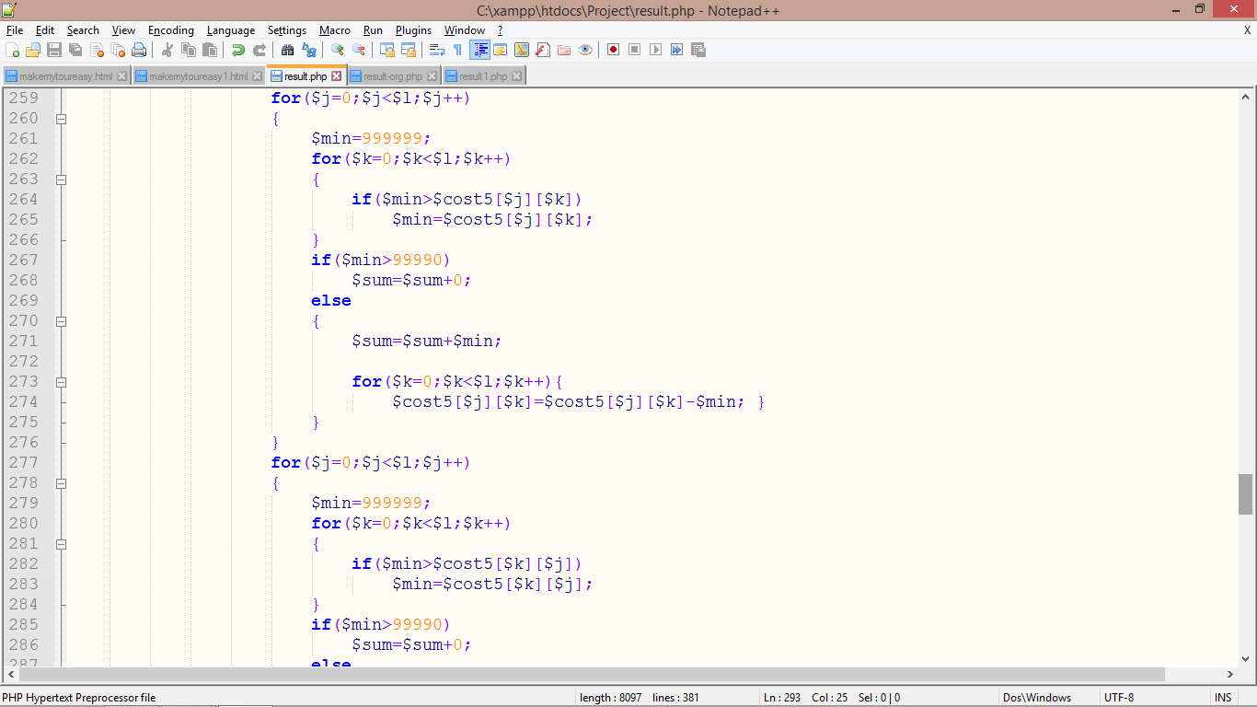
Applying row and column reduction for each path:

Slide 14
Path(1,3):
Placing the infinities in 1st row, 3rd column and at position (3,1),
and there by applying reduction on the resultant matrix, we obtain the cost of path (1,3) through the total cost subtracted for reduction.
1 2 3 4 5
1
2
3
4
5
∞ ∞ ∞ ∞ ∞
12 ∞ ∞ 2 0
∞ 3 ∞ 0 2
15 3 ∞ ∞ 0
11 0 ∞ 12 ∞
(-0)
(-0)
(-0)
(-0)
(-0)
1
2
3
4
5
(-11) (-0) (-0) (-0) (-0)
Cost=c1+(1,3)+0=25+17+11=53.

Slide 15
Continuing the same process for each path (1,4), (1,5) and the path obtained with minimum Cost is
chosen.
Here the minimum cost we obtain is (1,4) with a cost of ’25’.
Now the minimum cost from 4 to 2/3/5 are to be calculated in the same manner by taking the path(1,4) matrix as the main matrix.
This process is to be continued until all the nodes are covered.

Slide 16
1
2
3
4
5
2
3
5
3
5
3
The path obtained for the chosen example:
1->4->2->5->3->1

Slide 17
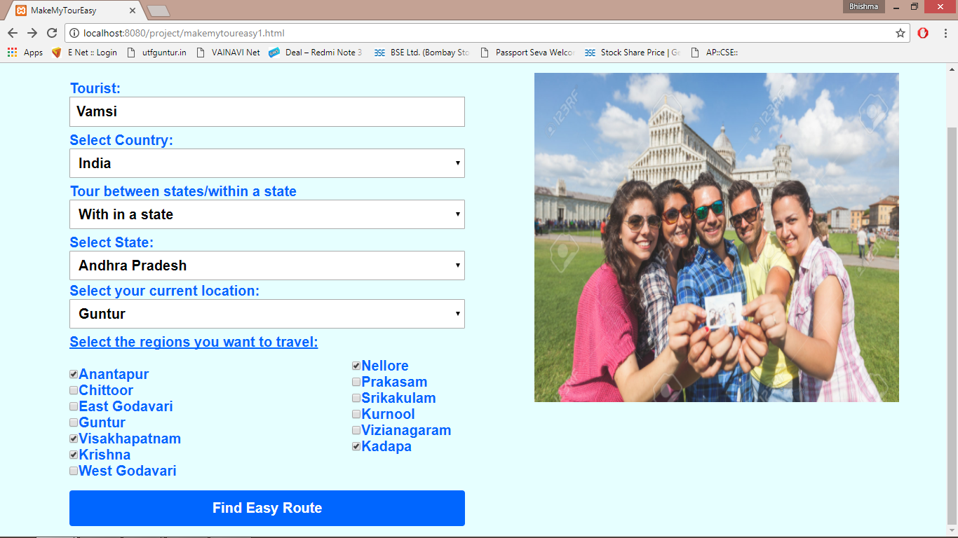
Front end prototype

Slide 18
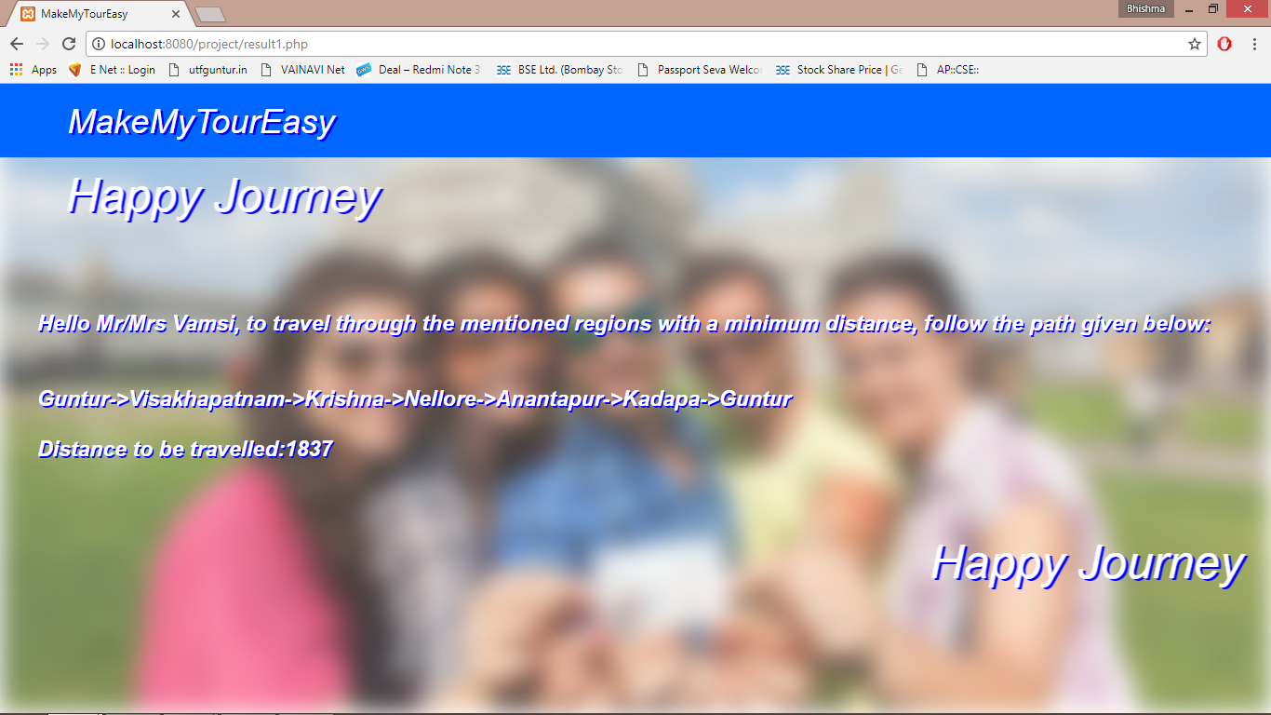
Prototype

Slide 19
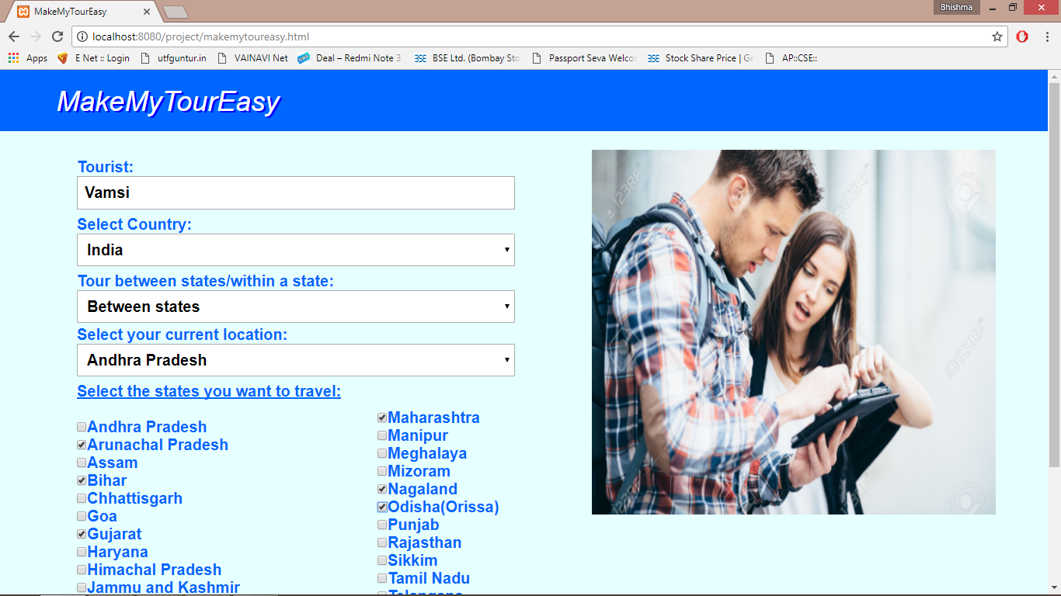
prototype

Slide 20
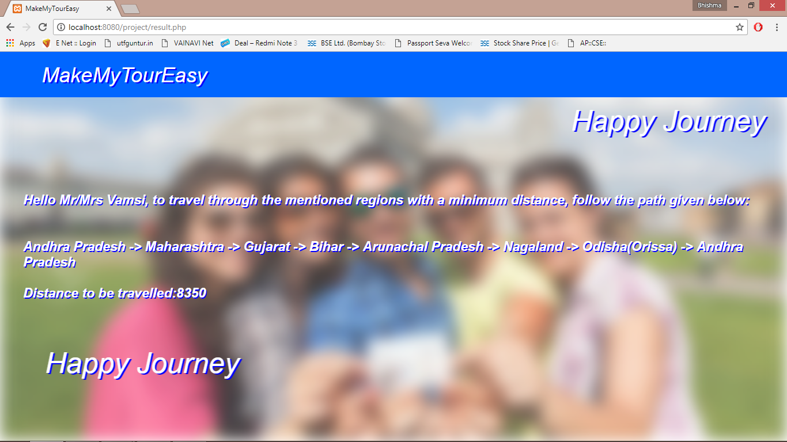
Prototype

Slide 21
Conclusion
Obtained the optimal path for the selected cities to be travelled, using branch and bound algorithm(travelling sales person problem algorithm).
REFERENCES
https://www.youtube.com/watch?v=RR7GXoWiUw4&t=2066s
https://www.w3schools.com/

Slide 22

Questions

